Slide 1


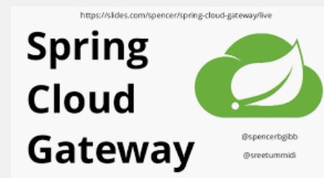
API GATEWAY in microservices
ARVIND

Slide 2
Real life scenario – Online Docs App
Doctor’s details
Disease details
Front End- Dashboard
Patient details
Location details
Medicine details

Slide 3
Problem statement
How the client of microservices can access microservices efficiently and effectively
Each client has the address of each microservice?
Some mid layer to manage the address of microservices and clients have address of this mid layer service?

Slide 4
Expectations from Microservices
Granularity/fine-details of API is deep in microservices.
Different clients different services
Latency need of clients
Network performance
Adaptability to location and address of microservices change
Ability to adapt the change is microservices in future
High availability

Slide 5
Solution – API gateway
A
P
I
G
A
T
E
W
A
Y
Doctor’s details
Disease details
Front End- Dashboard
Patient details
Location details
Medicine details

Slide 6
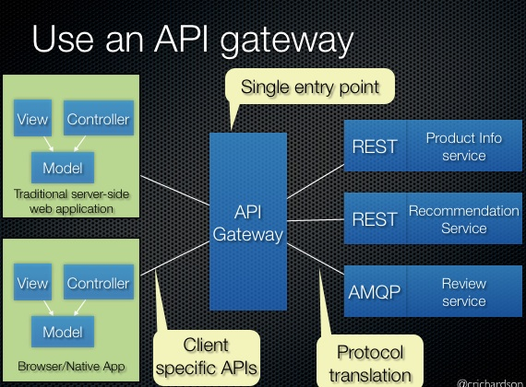
Api gateway..

Slide 7
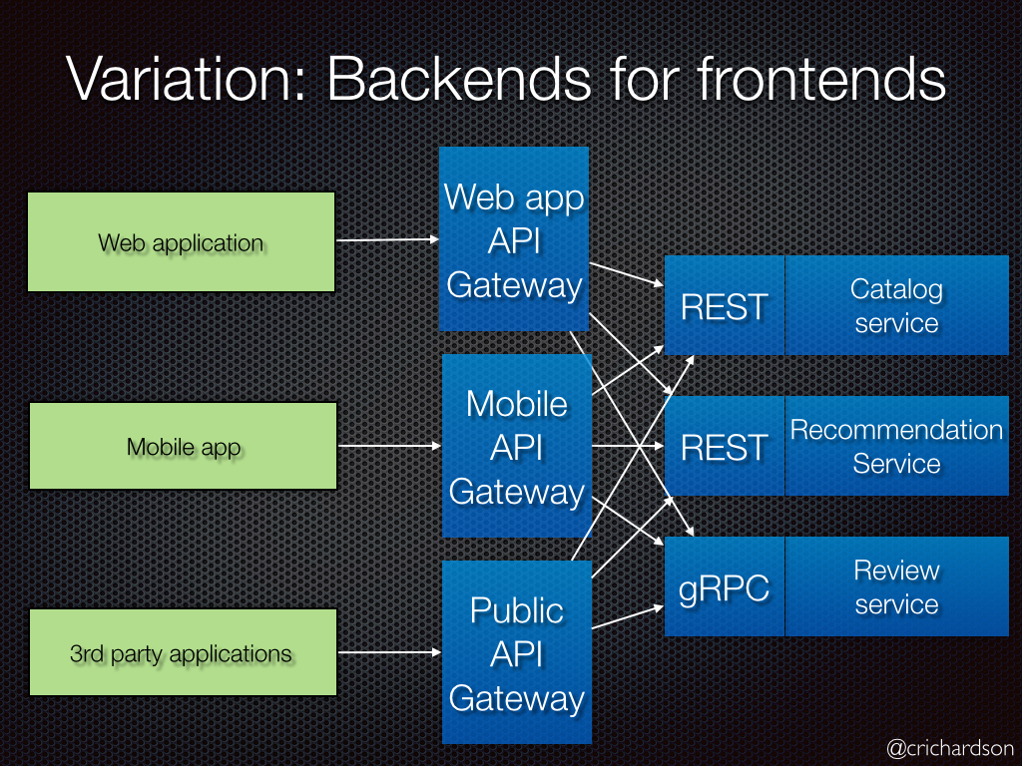
Api gateway..

Slide 8
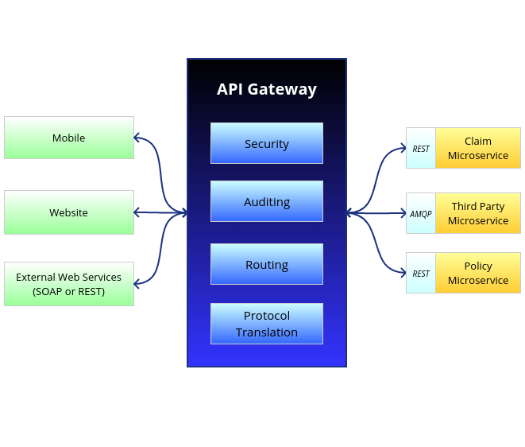
Api gateway..

Slide 9
Advantages of API Gateway
Separation between clients and microservices
Simplified clients
Any change in location of microservices is not going to affect the clients
Optimal API for each client as per requirement

Slide 10
Drawbacks of API Gateway
Complexity
Latency
One point failure

Slide 11
API gateway providers for microservices

Slide 12
API GATEWAY in microservices Netflix Zuul Routing requests
ARVIND

Slide 13
Solution – API gateway
A
P
I
G
A
T
E
W
A
Y
Doctor’s details
Disease details
Front End- Dashboard
Patient details
Location details
Medicine details

Slide 14
API GATEWAY in microservices Netflix Zuul How it works??
ARVIND

Slide 15
Solution – API gateway
A
P
I
G
A
T
E
W
A
Y
Doctor’s details
Disease details
Front End- Dashboard
Patient details
Location details
Medicine details

Slide 16
ZUUL internal architecture

Slide 17
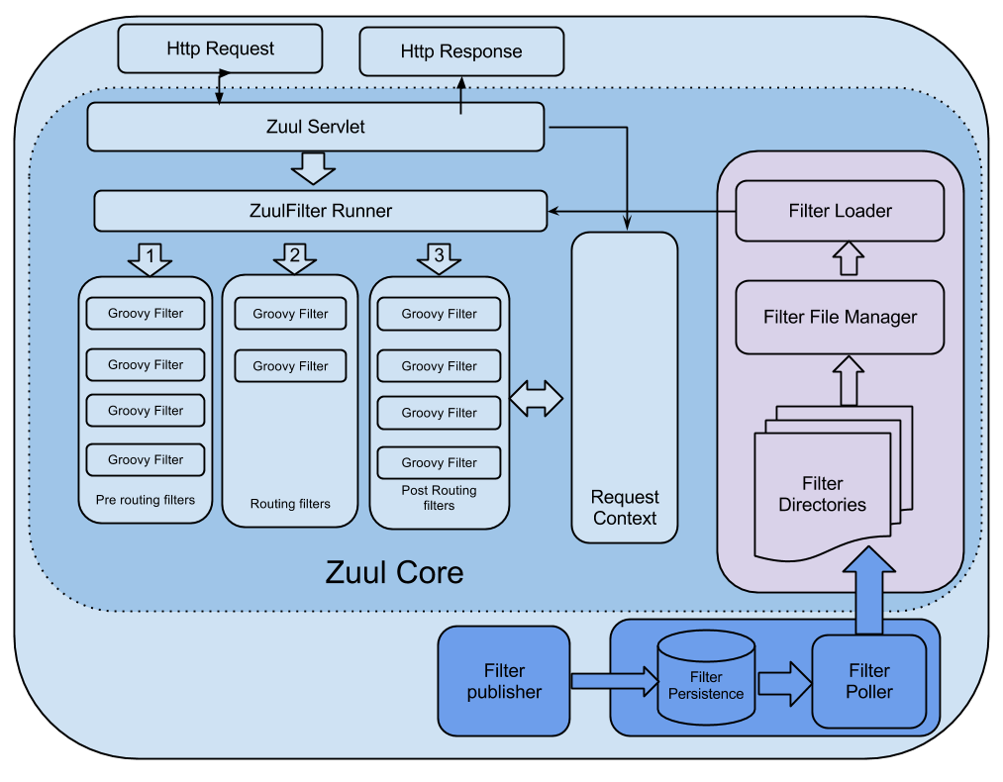

Slide 18
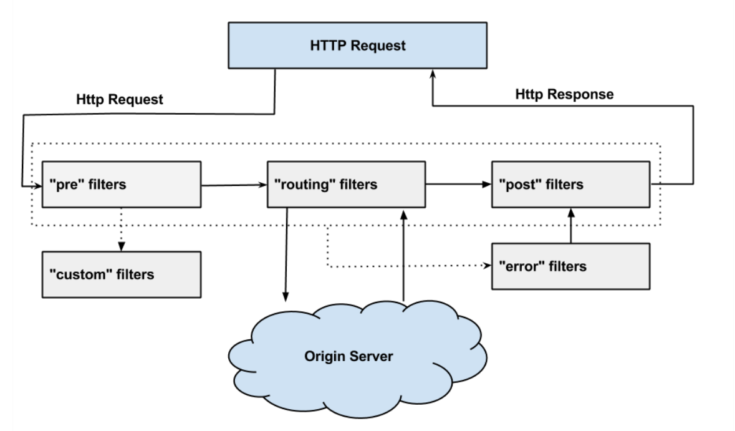
Zuul – Filters

Slide 19
Zuul – Filters
Type
Execution Order
Criteria
Action

Slide 20
API GATEWAY in microservices Netflix Zuul Filters(Demo)
ARVIND

Slide 21
Zuul – Filters(pre,post,error,route,custom)
Type
Execution Order
Criteria
Action

Slide 22
Solution – API gateway
A
P
I
G
A
T
E
W
A
Y
Doctor’s details
Disease details
Front End- Dashboard
Patient details
Location details
Medicine details

Slide 23
API GATEWAY in microservices Netflix Zuul actuator endpoints API Gateway Monitoring
ARVIND

Slide 24
Management Endpoints
https://cloud.spring.io/spring-cloud-netflix/multi/multi__router_and_filter_zuul.html#_management_endpoints

Slide 25
API GATEWAY in microservices Netflix Zuul LOGGING/AUDITING
ARVIND

Slide 26
Solution – API gateway
A
P
I
G
A
T
E
W
A
Y
Doctor’s details
Disease details
Front End- Dashboard
Patient details
Location details
Medicine details

Slide 27
API GATEWAY in microservices Netflix Zuul security
ARVIND

Slide 28
Solution – API gateway
A
P
I
G
A
T
E
W
A
Y
Doctor’s details
Disease details
Front End- Dashboard
Patient details
Location details
Medicine details

Slide 29
Thanks for your time

